Slide 1

GIS & Applications

Slide 2

GIS & Applications
GIS, Remote Sensing and GNSS
GIS Applications

Slide 3
GIS, Remote Sensing and GPS
Geographic Information System
GIS
GNSS
RS
Global Navigation Satellite System
Remote Sensing

Slide 4
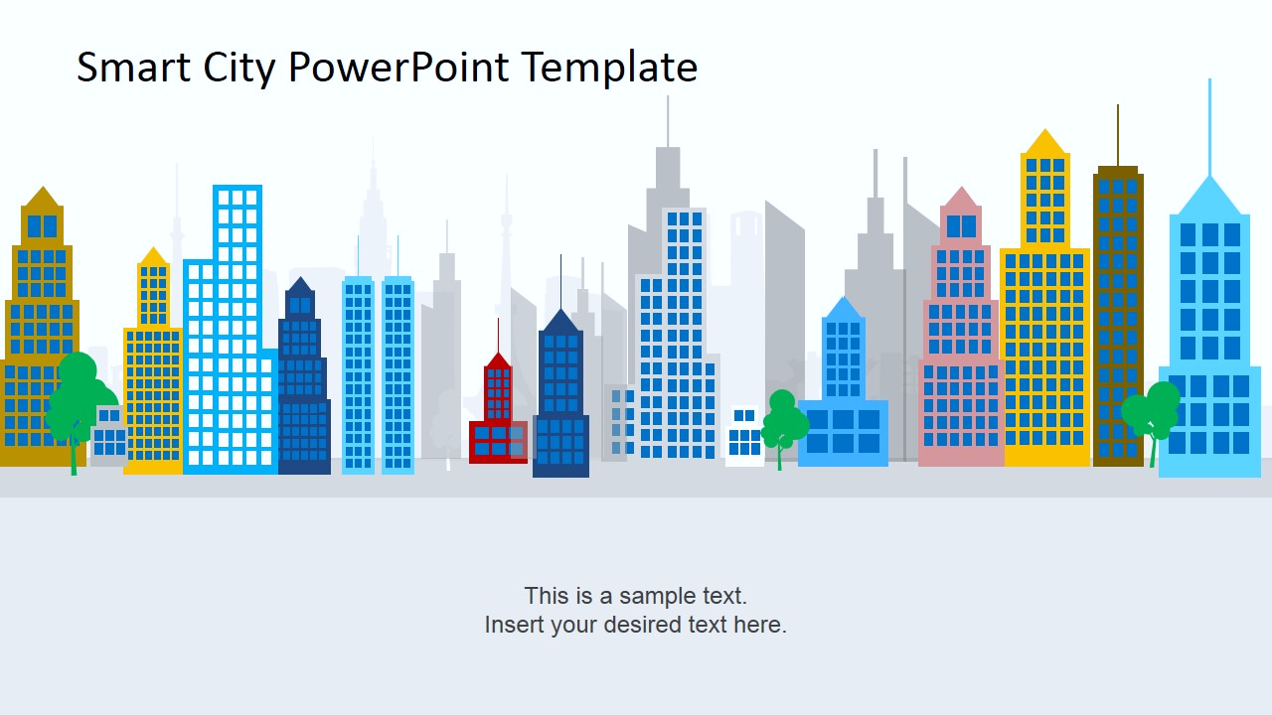
GIS LÀ GÌ?
GIS = Geographic Infromation System – Hệ thống thông tin Địa lý
Hệ thống thông tin địa lý là hệ thống thu thập và nhập, lưu trữ, truy vấn và phân tích, hiển thị và xuất thông tin địa lý
Hệ thống thông tin Địa lý = Hệ thống thông tin + Bản đồ

Slide 5
CÁC THÀNH PHẦN CỦA GIS
Con người
01
Phần cứng
05
04
GIS
02
Quy trình
Phần mềm
03
Dữ liệu

Slide 6
CÁC CHỨC NĂNG CHÍNH CỦA GIS
Nhập dữ liệu
Quản lý dữ liệu
Truy vấn và phân tích
Hiển thị, kết xuất dự liệu

Slide 7
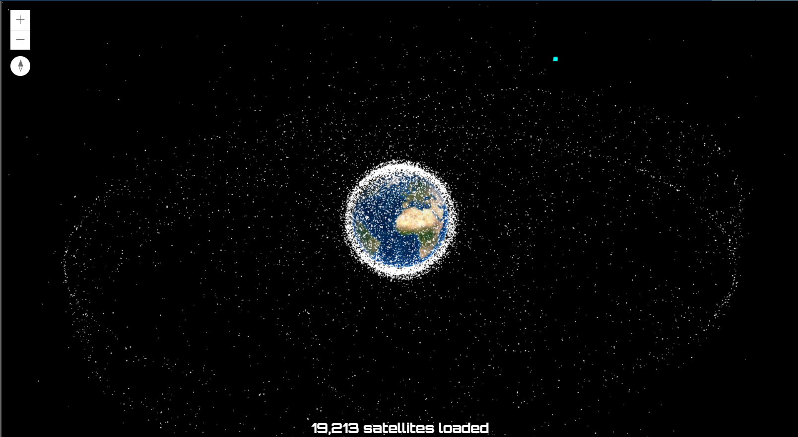
Satellite System
4,084 operational satellites (Union of Concerned Scientists (UCS), Updated May 1, 2021)
United States: 2,505
Russia: 168
China: 431
Other: 980
https://www.ucsusa.org/resources/satellite-database
https://maps.esri.com/rc/sat2/index.html

Slide 8
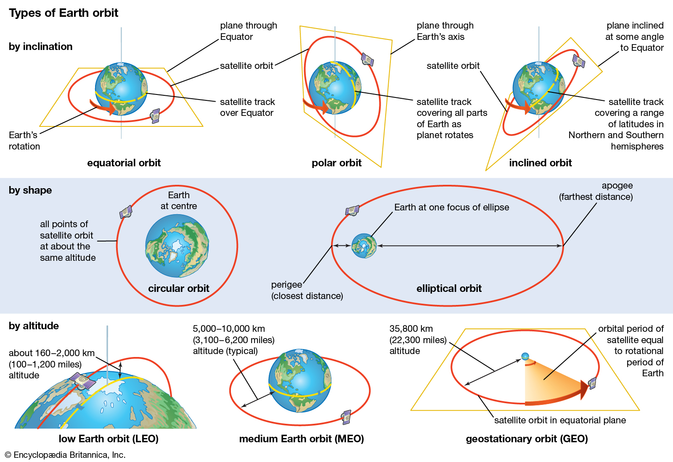
Types of Orbit

Slide 9
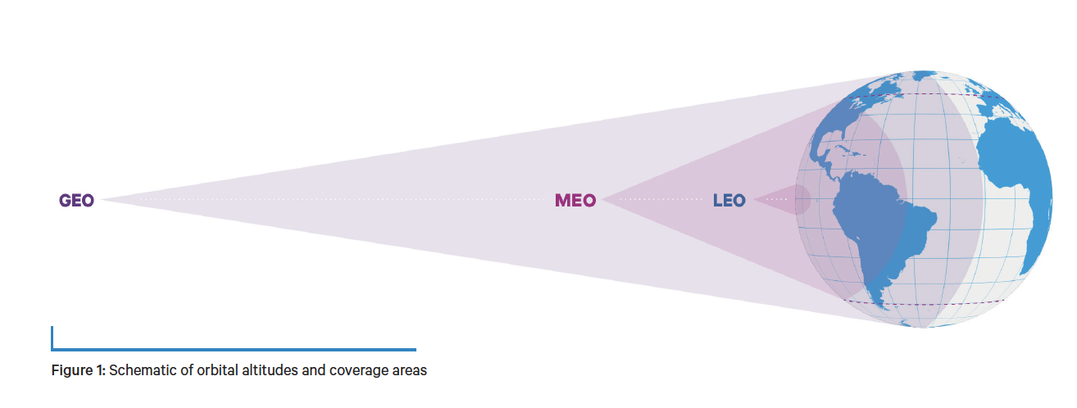
Types of Orbit
Geostationary orbit (GEO)
Low Earth orbit (LEO)
Medium Earth orbit (MEO)
Polar orbit and Sun-synchronous orbit (SSO)
Transfer Orbits and Geostationary Transfer Orbit (GTO)

Slide 10
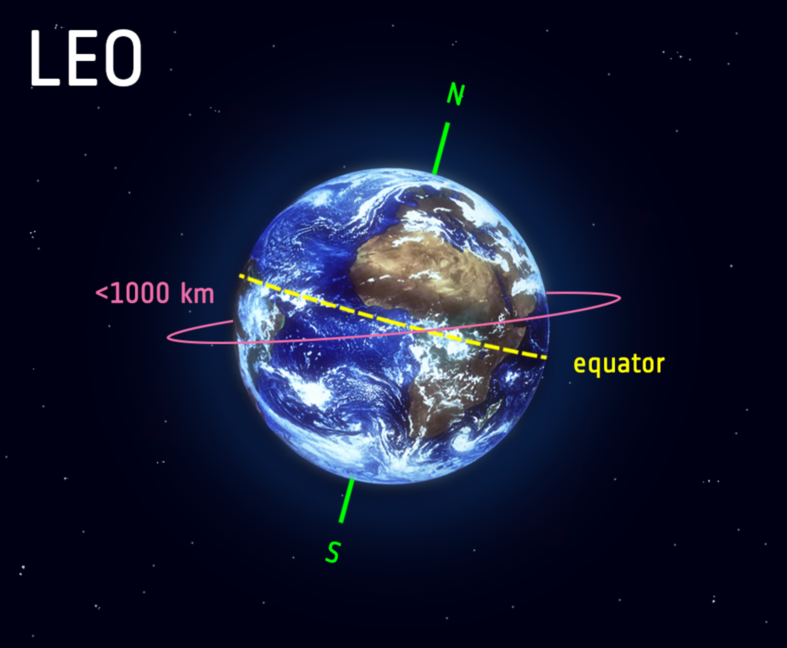
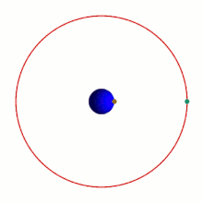
Low Earth Orbit (LEO)
Altitude: 160 km - 1000 km.
Speed: 7.8km/ sec (90 minutes to circle Earth = 16 times/ day)
Often work as part of a large combination or constellation, of multiple satellites to give constant coverage.
Applications: satellite imageing, International Space Station (ISS - 408 km)

Slide 11
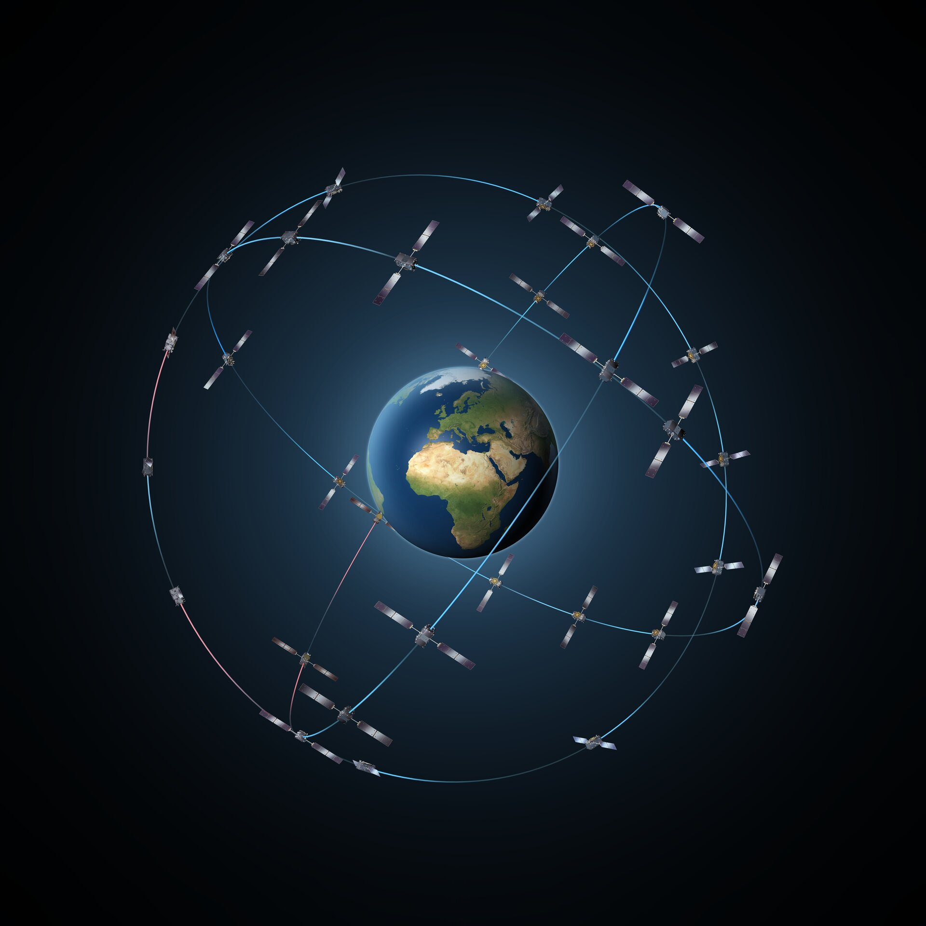
Medium Earth Orbit (MEO)
Altitude: 5000 - 20000 km
Period: 12 hrs
Applications: Navigation, telccommunication, geodetic/ space einvironment science.

Slide 12
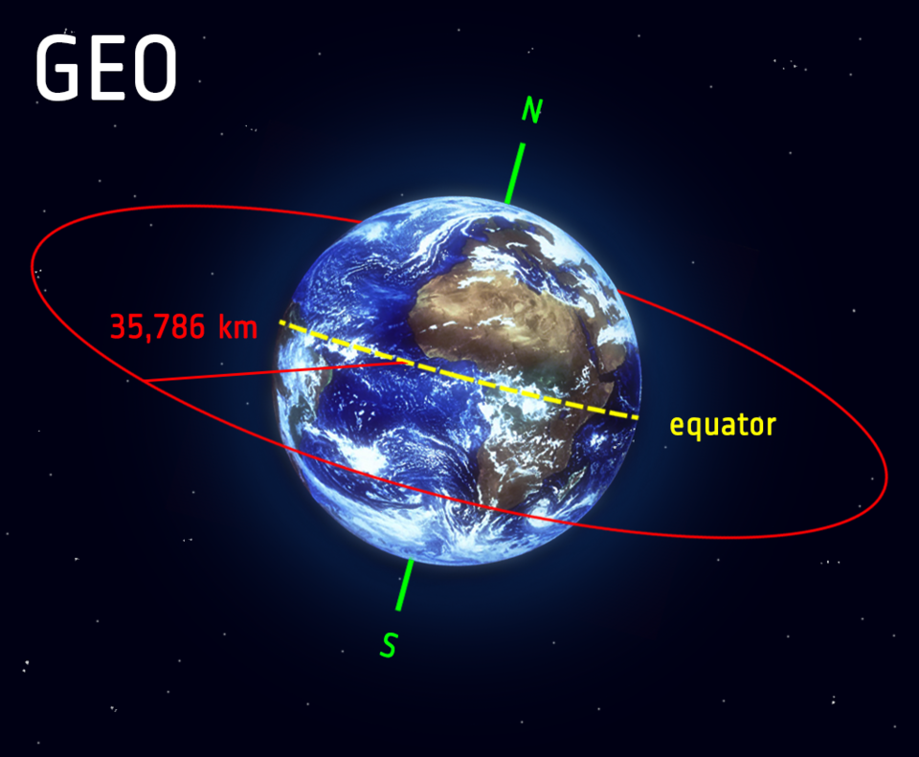
Geostationary Orbit (GEO)
Altitude: 35.786 km
Speed: 3km/sec
Period: 24 hrs
Above the equator, from West to East
Following Earth’s rotation
Appear to be ‘stationary’ over a fixed position
3 equally-spaced satellites can provide near global coverage
Applications: telecommunication (Vinasat), weather monitoring

Slide 13
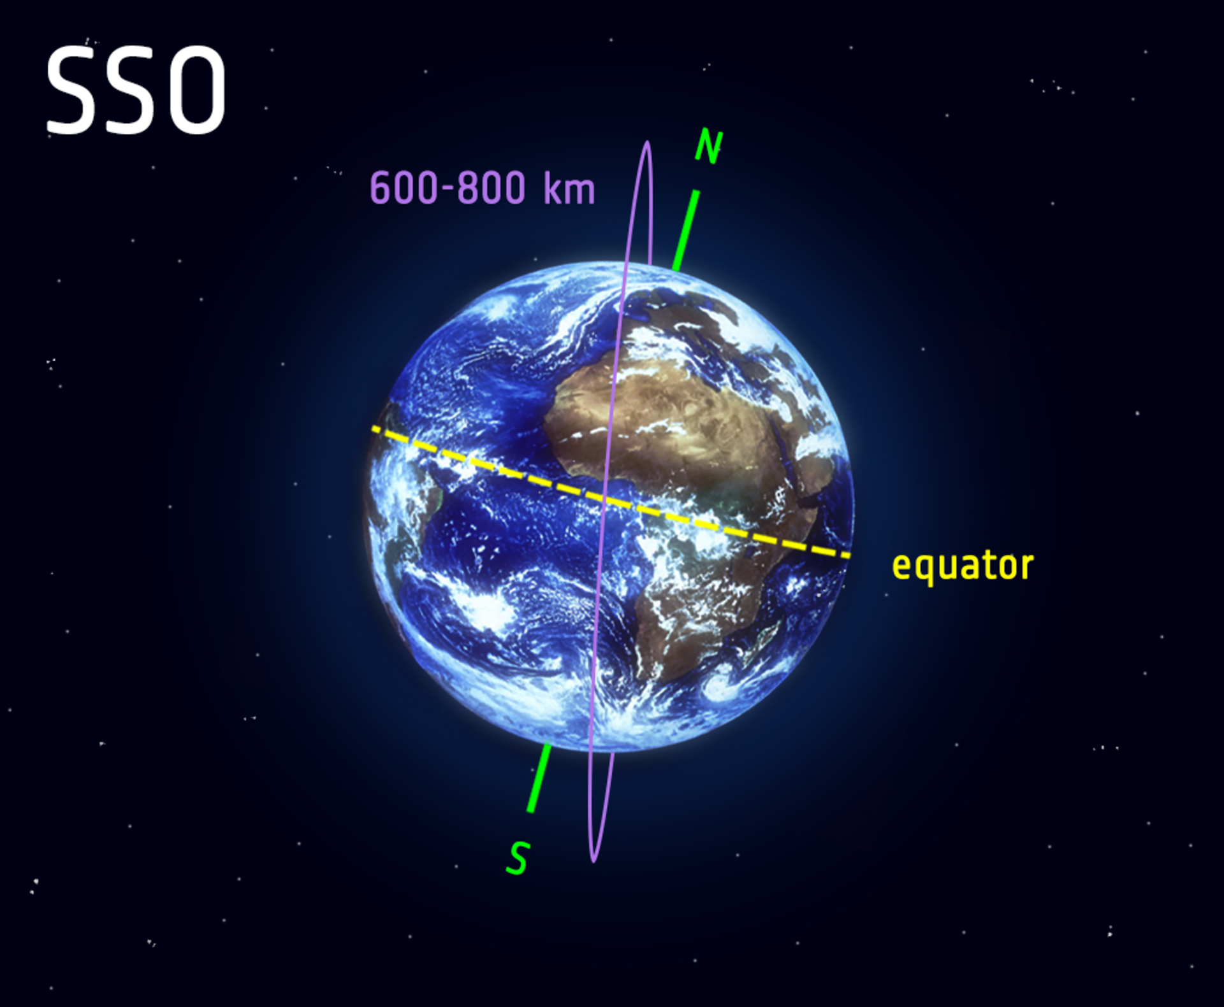
Polar Orbit and Sun-Synchronous Orbit (SSO)
Polar Orbit: travel from North - South, type of Low Earth Orbit
Sun-Synchronous Orbit:
Type of Polar Orbit
Altitude: 600 - 800km
Speed: 7.5km/ sec
Synchronous with the Sun: alwaws vistis the same spot at the same local time
Appllications: change detection over time, weather forecast, emergency monitoring: deforestation, sea level rise

Slide 14
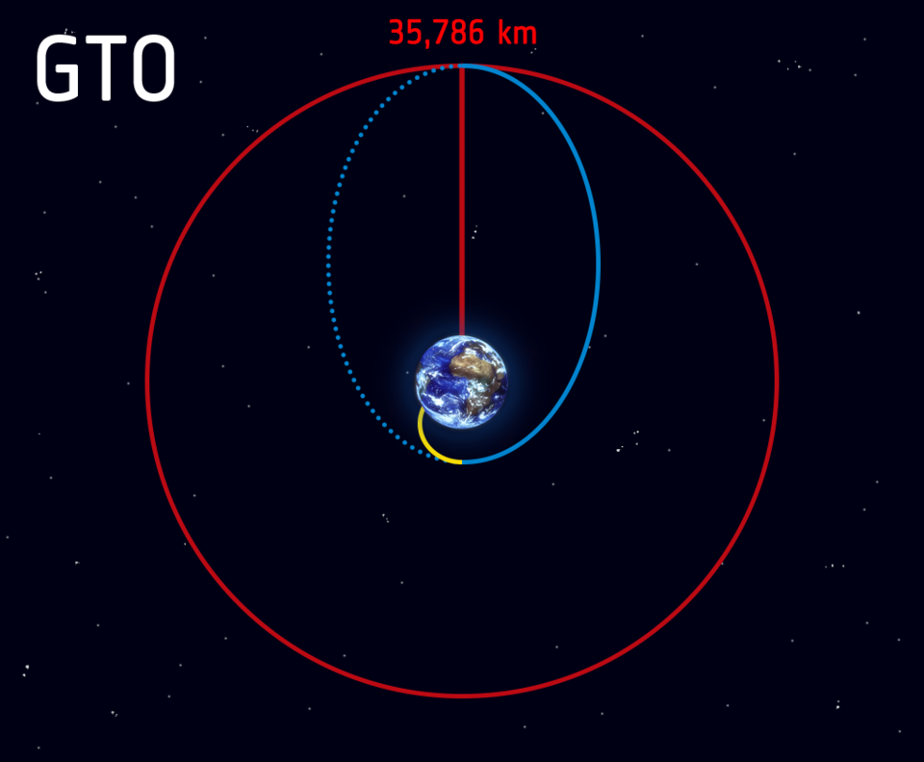
Transfer Orbits and Geostationary Transfer Orbit (GTO)
Launch and ascent to space (yellow line) becomes the geostationary transfer orbit (blue line) when the rocket releases the satellite in space on a path to geostationary orbit (red line).

Slide 15
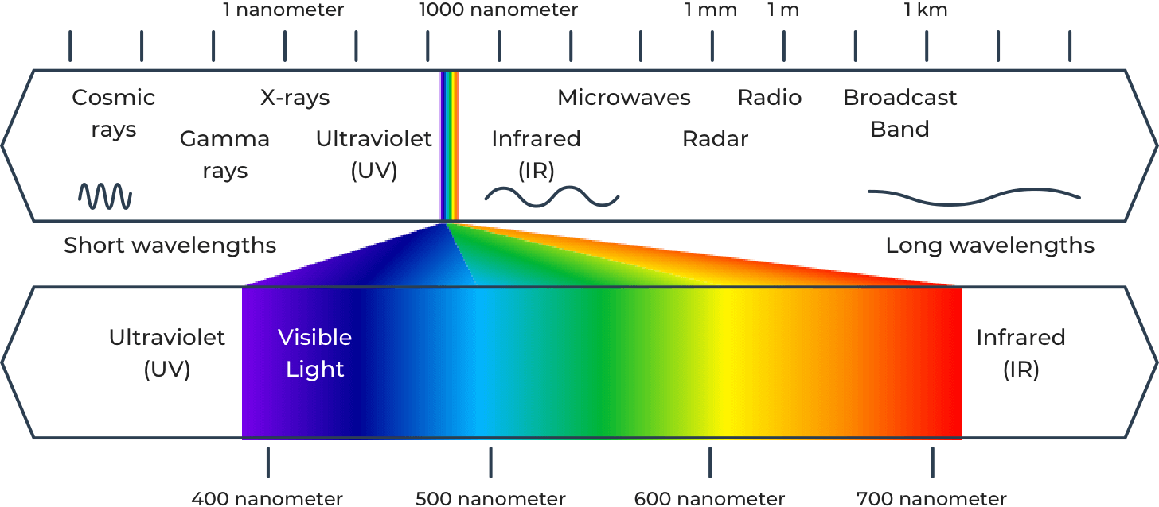
Remote Sensing

Slide 16
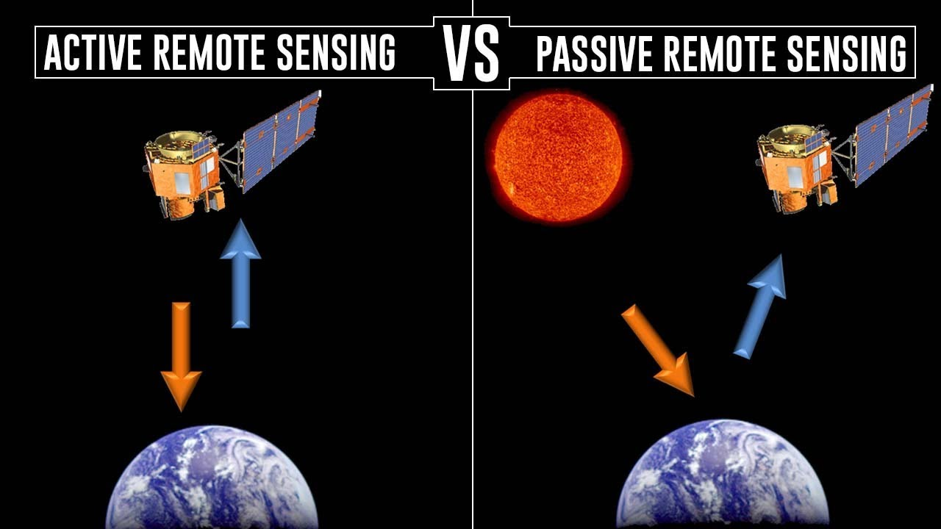
Remote Sensing: Active vs Passive
Ex: RADAR, LiDAR
Ex: Landsat, MODIS

Slide 17
Remote Sensing: Types of Resolution
Spatial Resolution: Pixel size - the smallest unit measured by a sensor
Spectral Resolution: Number of bands
Radiometric Resolution: Color depth - the ability to discriminate very slight differences in energy
Temporal Resolution: How frequently a satellite observes the samer area of the earth

Slide 18
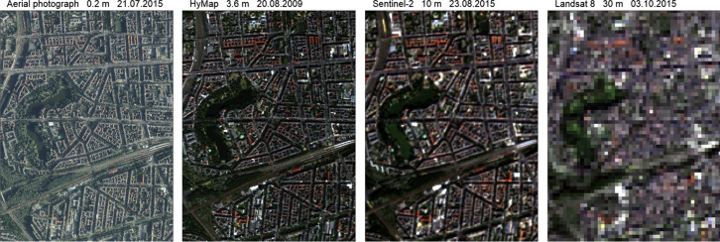
Remote Sensing: Types of Resolution
Spatial Resolution: Pixel size - the smallest unit measured by a sensor
Low resolution: over 60m/pixel
Medium resolution: 10 ‒ 30m/pixel
High to very high resolution: 30cm ‒ 5m/pixel

Slide 19
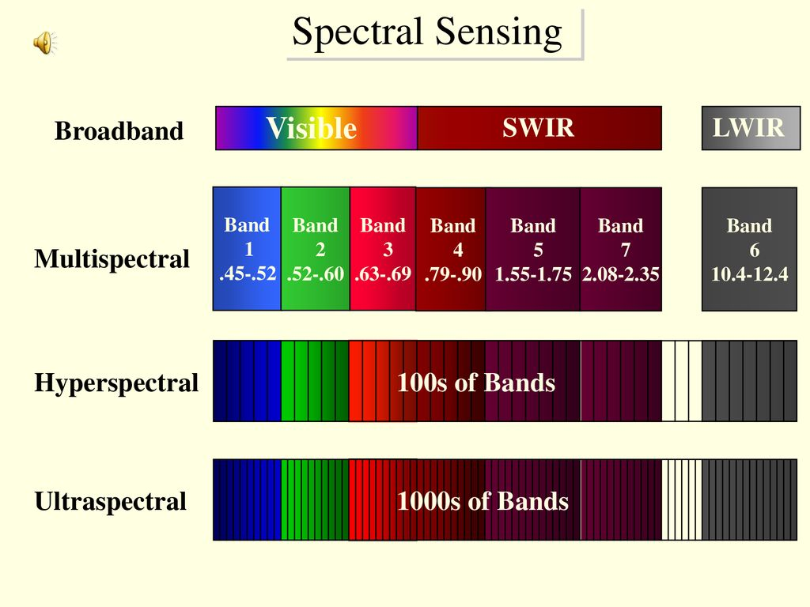
Remote Sensing: Types of Resolution
Spectral Resolution: Number of bands

Slide 20
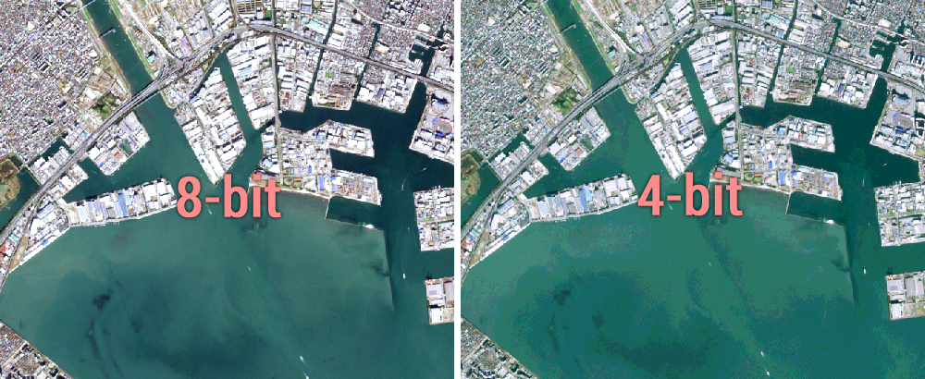
Remote Sensing: Types of Resolution
Radiometric Resolution: Color depth
256 colors
16 colors

Slide 21
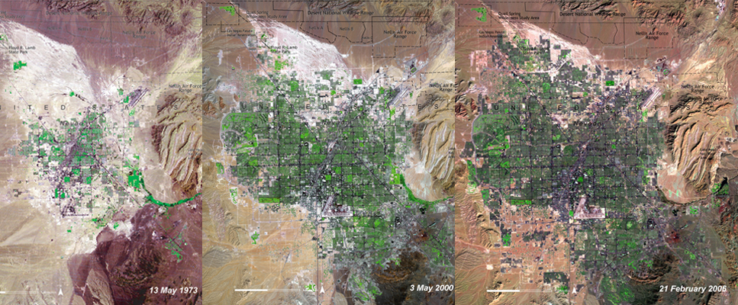
Remote Sensing: Types of Resolution
Temporal Resolution: How frequently a satellite observes the samer area of the earth

Slide 22
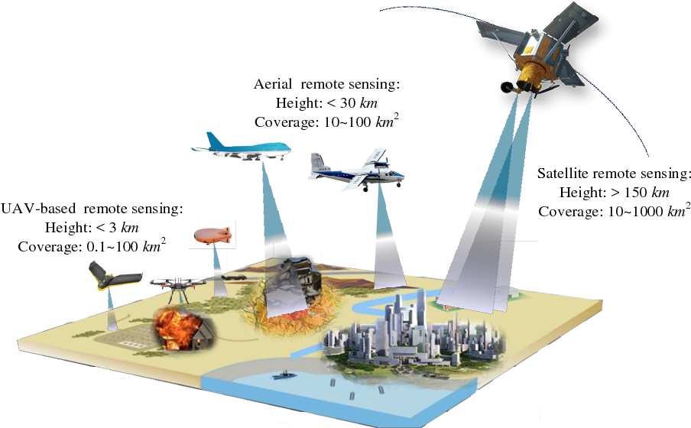
Remote Sensing
Satellite
Aerial
UAV

Slide 23
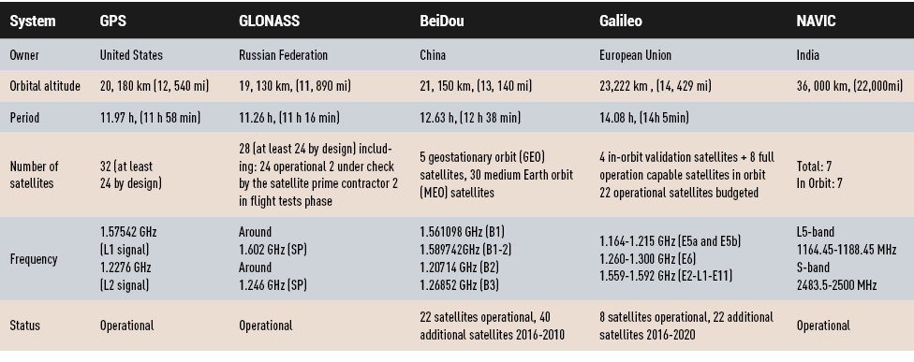
GNSS - Global Navigation Satellite System

Slide 24
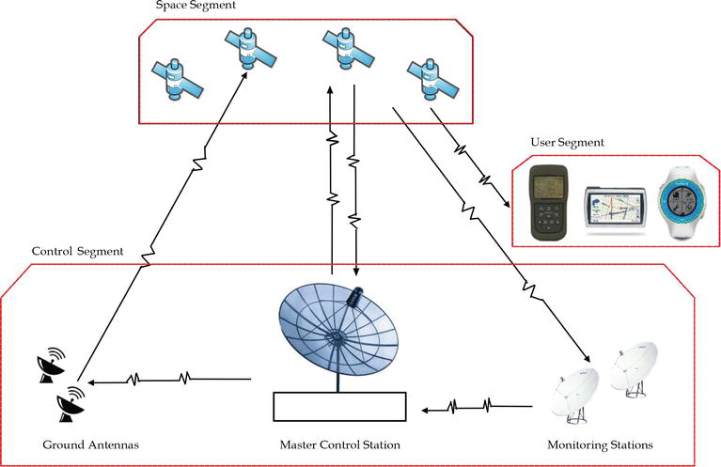
GNSS - Global Navigation Satellite System

Slide 25
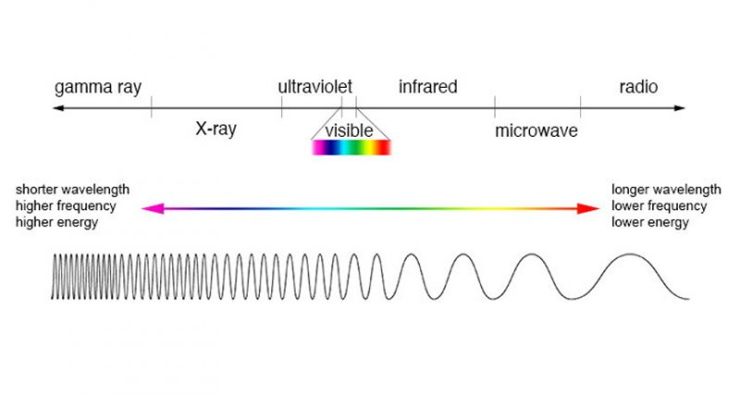
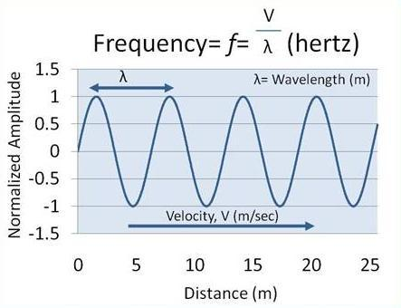
GNSS - Global Navigation Satellite System
Radio wave:
- Wavelength: 1 mm - 30,000 meters
- Frequency: 10 KHz - 300,000 MHz

Slide 26
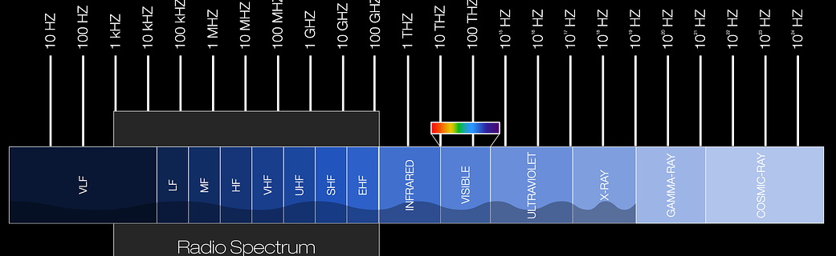
Navstar GPS - USA
Navigation Satellite Timing & Ranging - Global Positioning System
Military use: 1978
Global use: 1994
Constellation: 24 (available)/32 satellites, 6 equally-spaced orbital planes
Altitude: 20200 km (Medium Earth Orbit - MEO)
Period: 12hrs
Frequencies: L1 (1575.42 MHz) and L2 (1227.60 MHz), L5 (1176.45 Mhz)

Slide 27
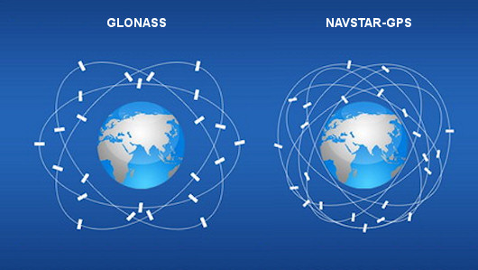
Navstar GPS - USA
3 orbital planes vs 6 orbital planes

Slide 28
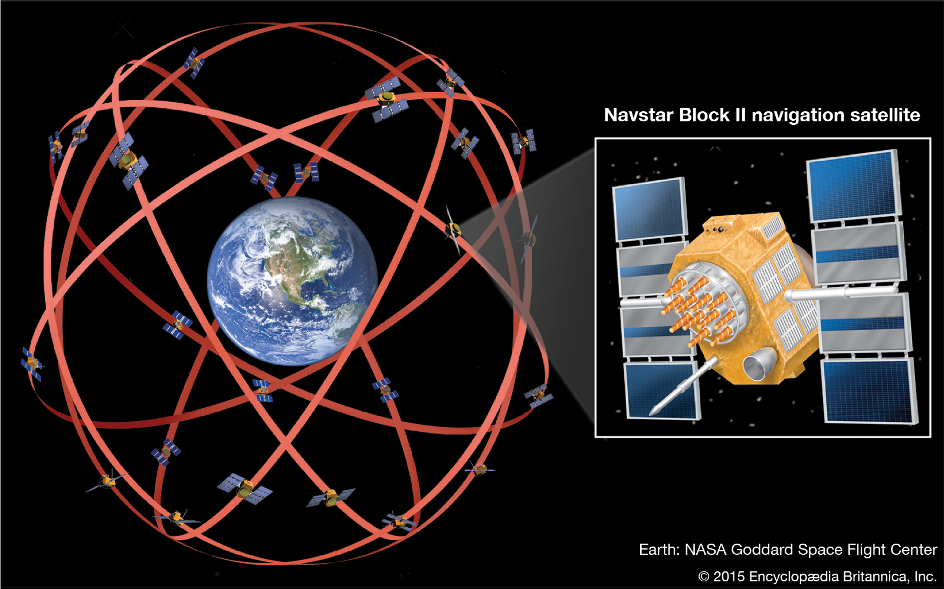
Navstar GPS - Space Segment

Slide 29
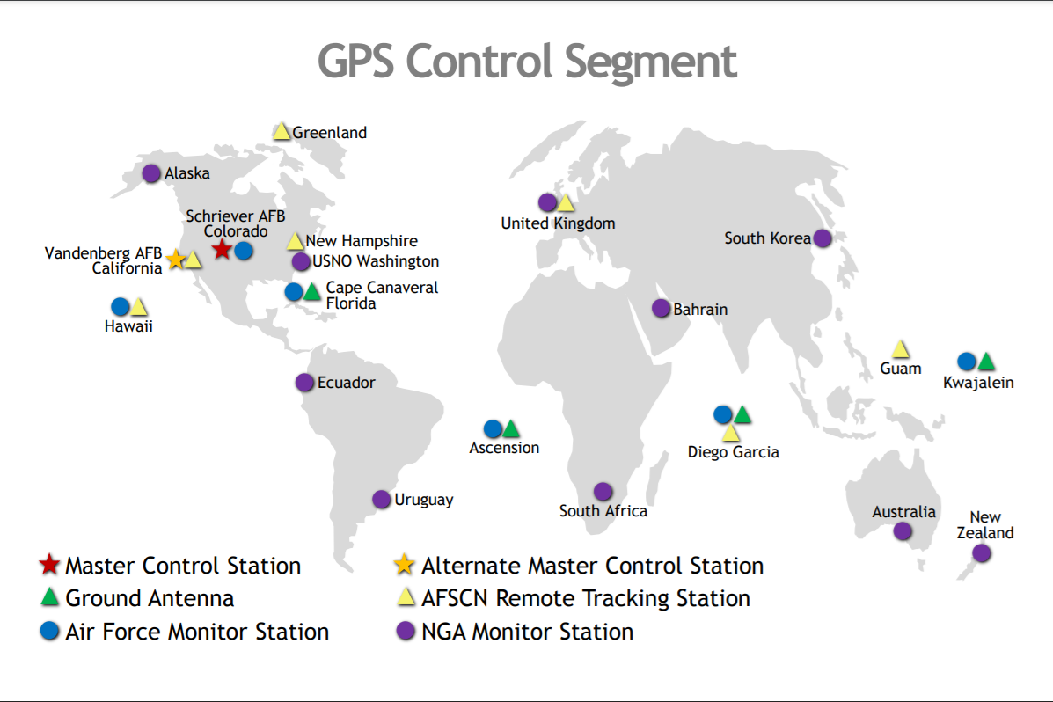
Navstar GPS - Control System

Slide 30
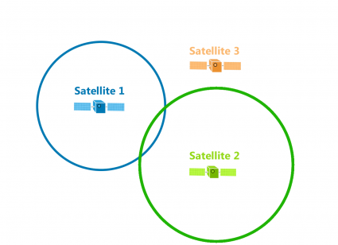
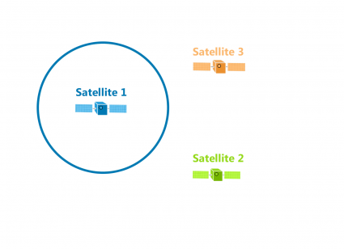
Navstar GPS - User Segment
Trilateration

Slide 31
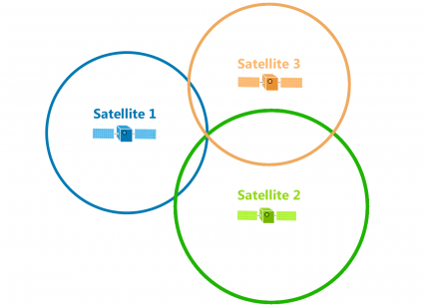

Navstar GPS - User Segment
Trilateration

Slide 32
GIS Applications
Location-based Services
Visualization, Modeling, Simulation and Decision Support: IoT, Real-time Geospatial Data, GeoSpatial Big Data, GeoAI, 3D GIS

Slide 33
Location-based Services
GeoLocation:
Google Plus Code (Open Location Code - OLC)
Place Key
What3Words (W3W)
...

Slide 34
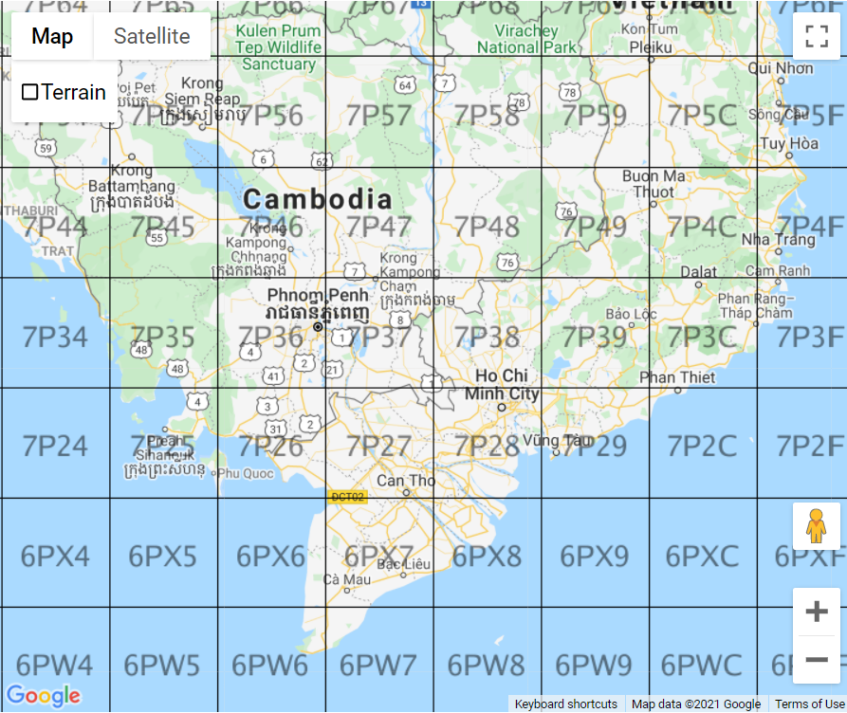
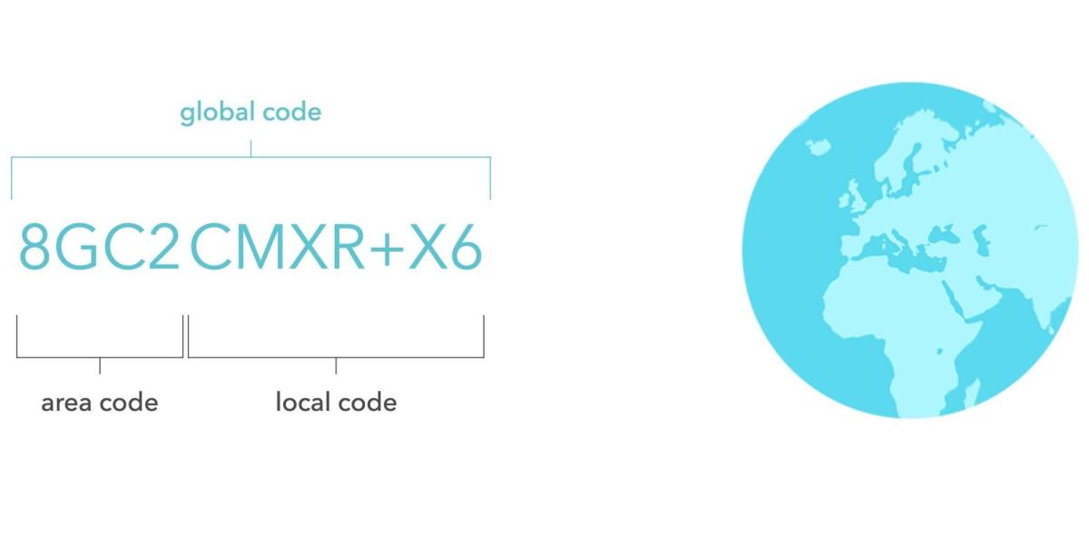
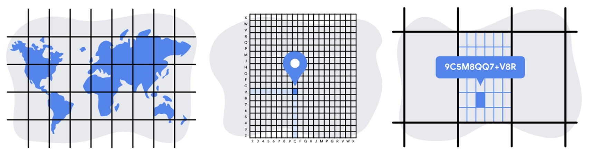
Location-based Services
Google Plus Code:
- Hierarchical Square Grid

Slide 35
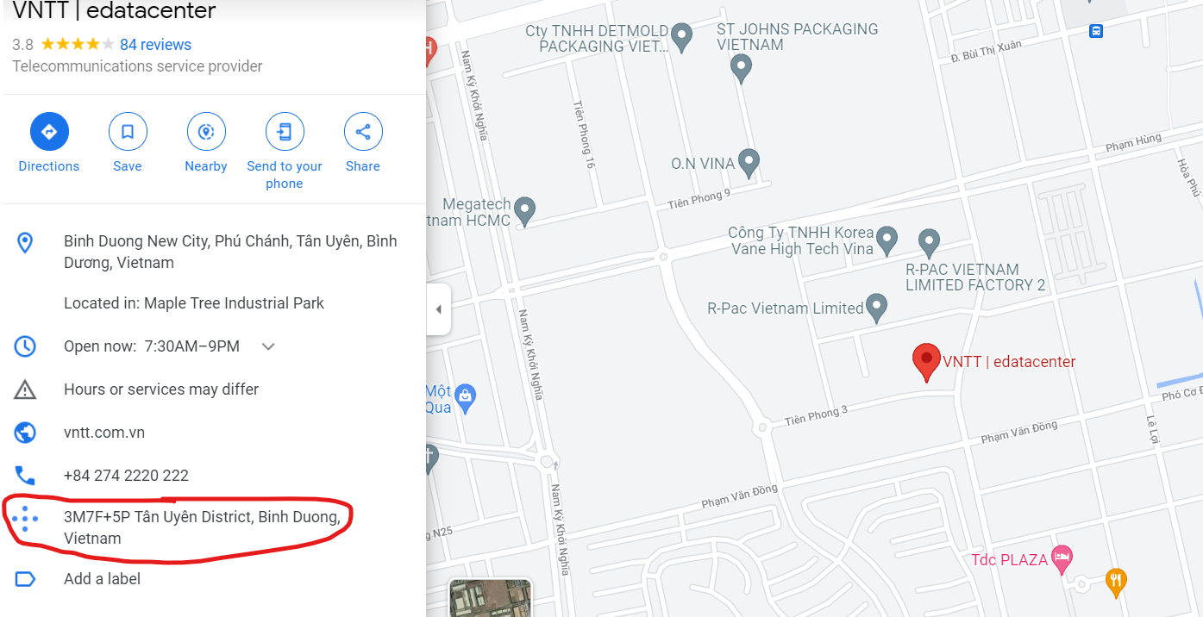
Location-based Services
Google Plus Code (Open Location Code - OLC)

Slide 36
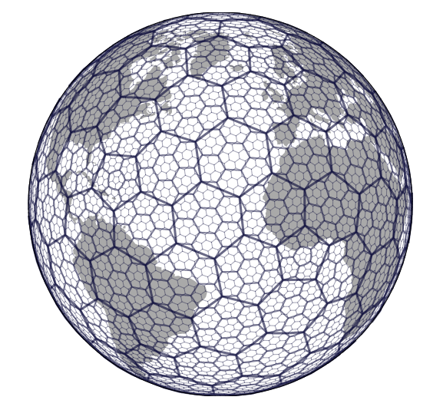
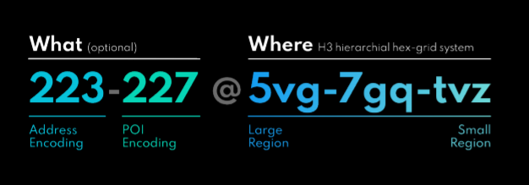
Location-based Services
Place Key:
- H3 Hexagonal Hierarchical Spatial Index

Slide 37
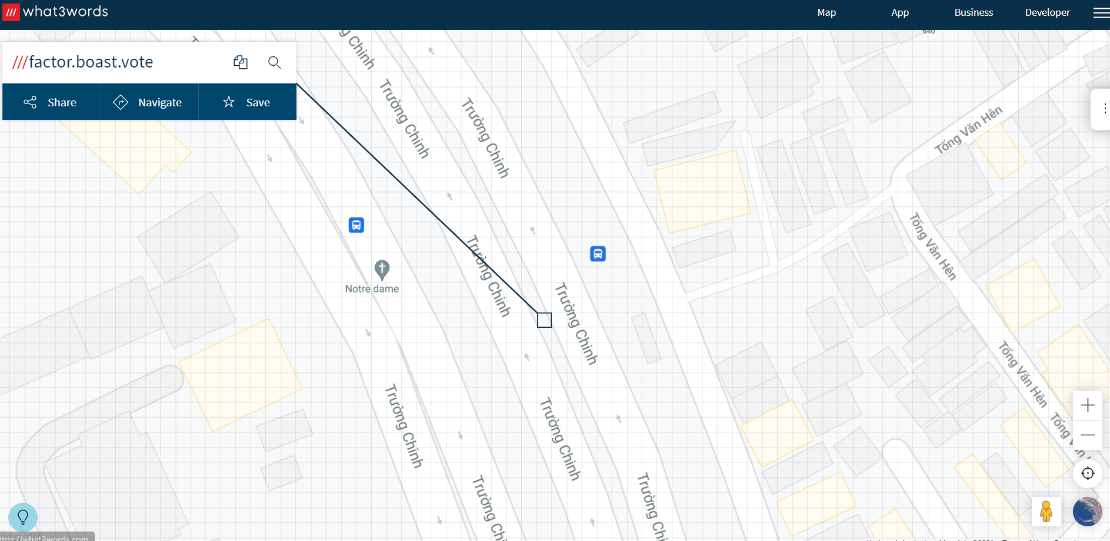
Location-based Services
Place Key:
3m x 3m Square grid
3 words/ grid cell

Slide 38
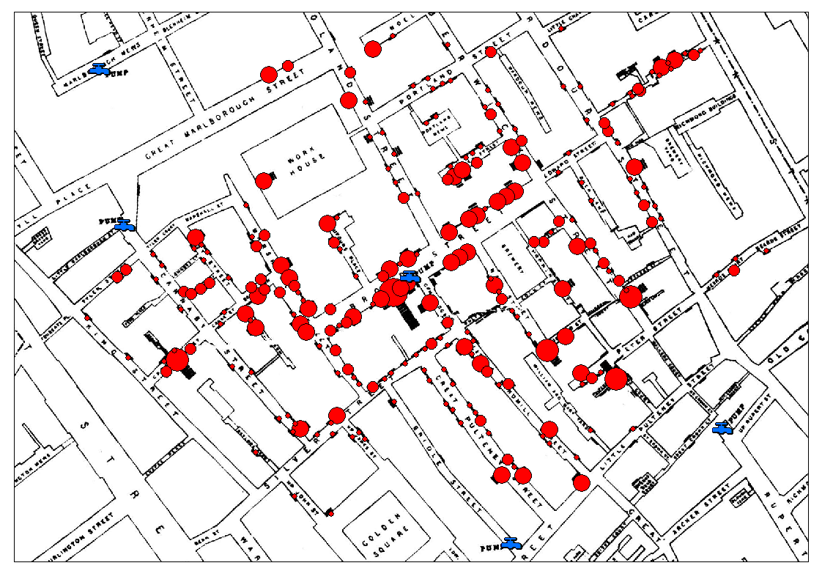
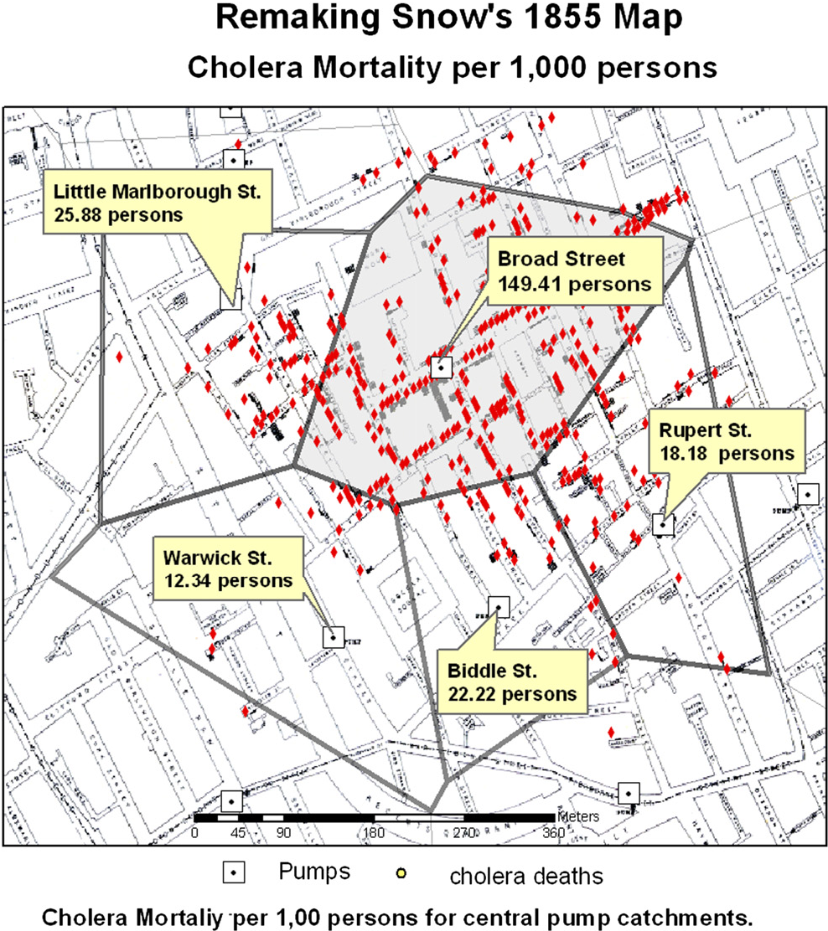
Location-based Services
Spatial Analysis
John Snow’s Cholera Map - 1855

Slide 39
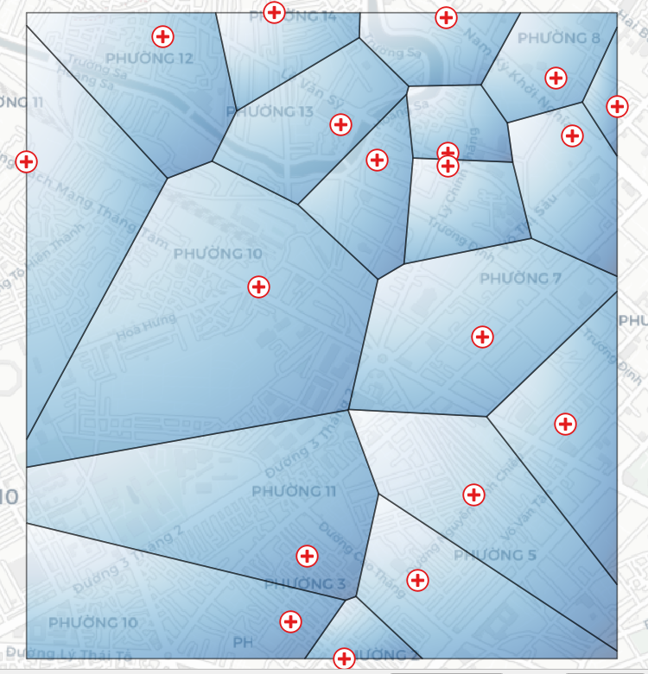
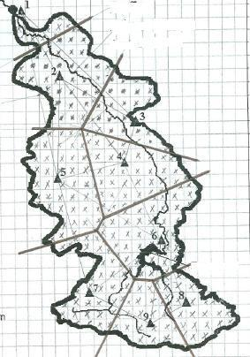
Location-based Services
Voronoi Diagram
Average Rainfall based on Thieseen Polygon
Service Areas

Slide 40
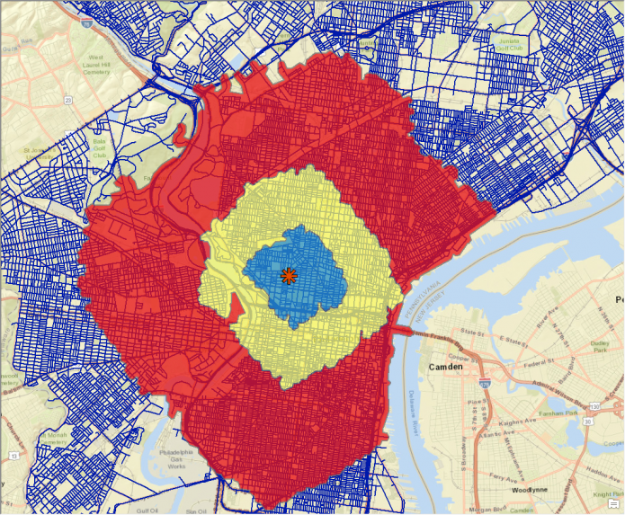
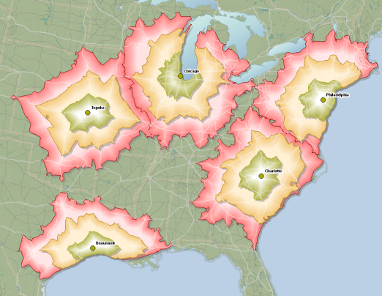
Location-based Services
Service Areas regarding road network

Slide 41
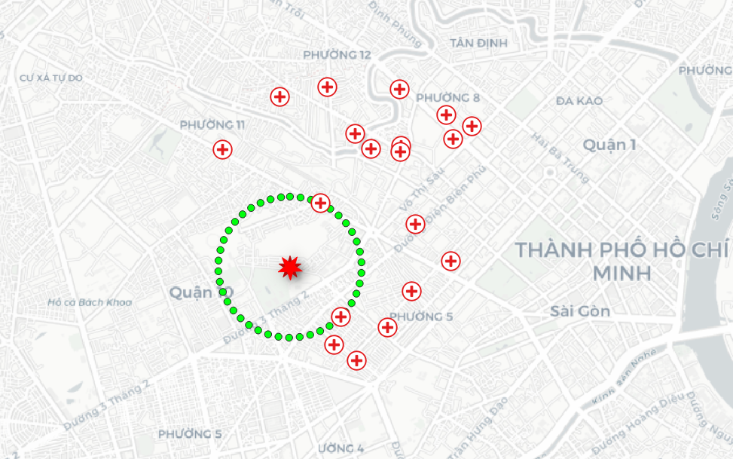
Location-based Services
Largest Empty Circle

Slide 42
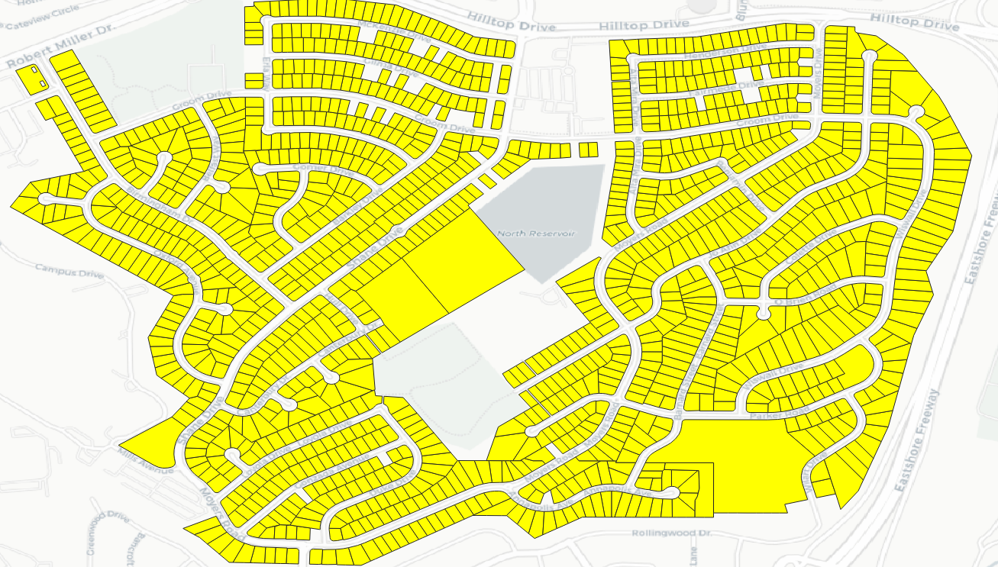
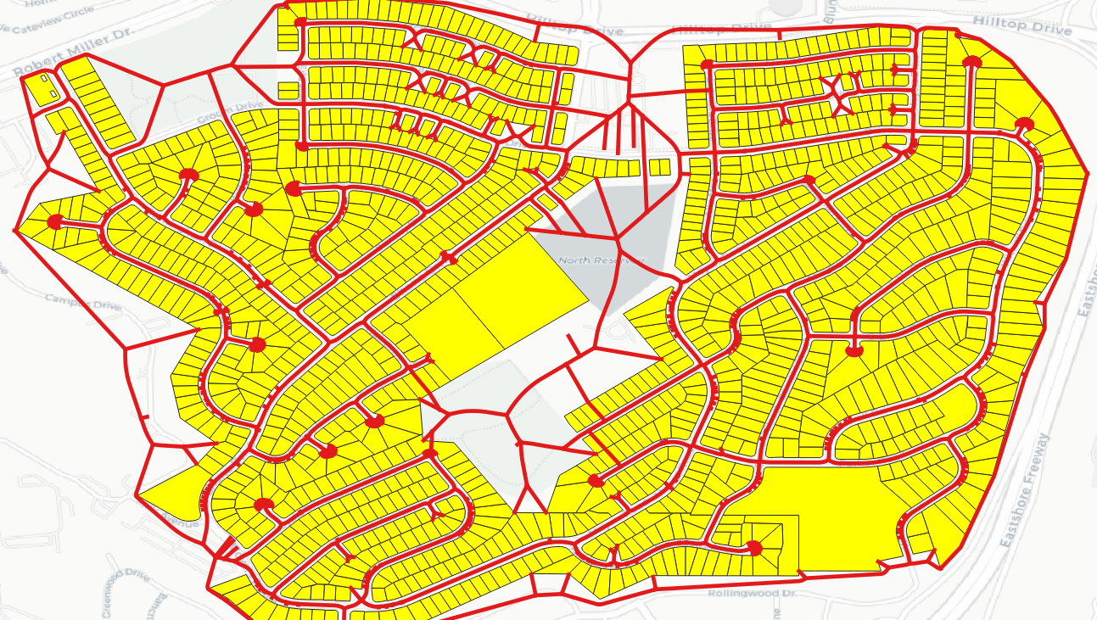
Location-based Services
Utilities Network Planning

Slide 43
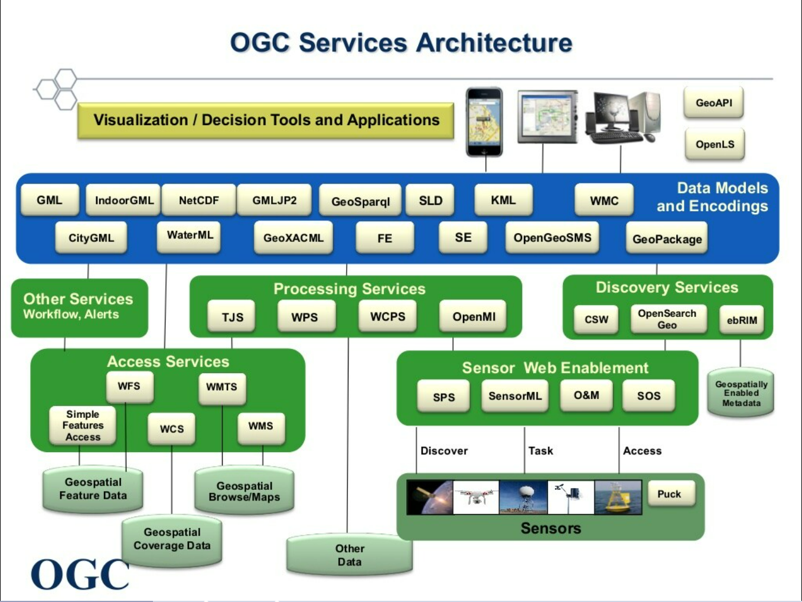
Visualization, Modeling, Simulation and Decision Support

Slide 44
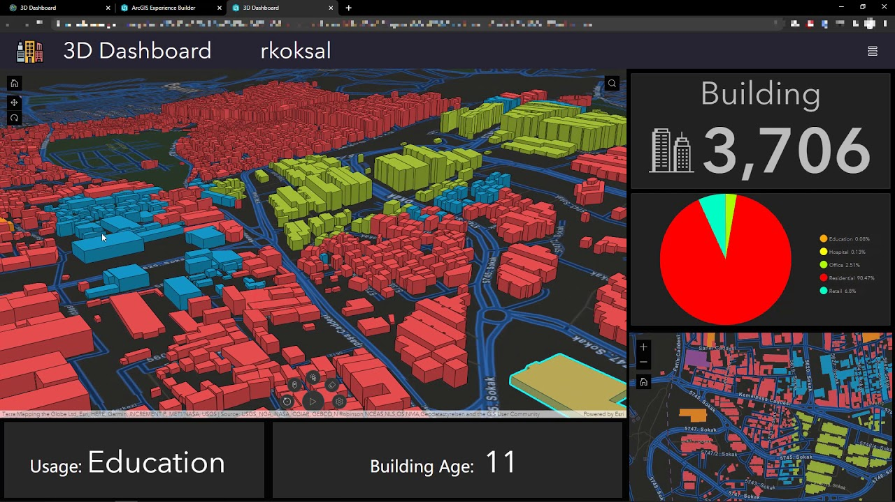
Visualization, Modeling, Simulation and Decision Support
GIS Dashboard - Smart City Operations

Slide 45
3D GIS
City planning
Lanscape planning
Civil engineering
Automatic Vehicle Navigation
Environmental Monitoring
Disaster Response
BIM-GIS Integration (BIM = Building Information Modeling)
OGC Standards:
3D Tiles
3dP
CityGML
CityJSON
I3S
Indoor Mapping Data Format (IMDF)
IndoorGML
KML
LandInfra/InfraGML
LAS

Slide 46
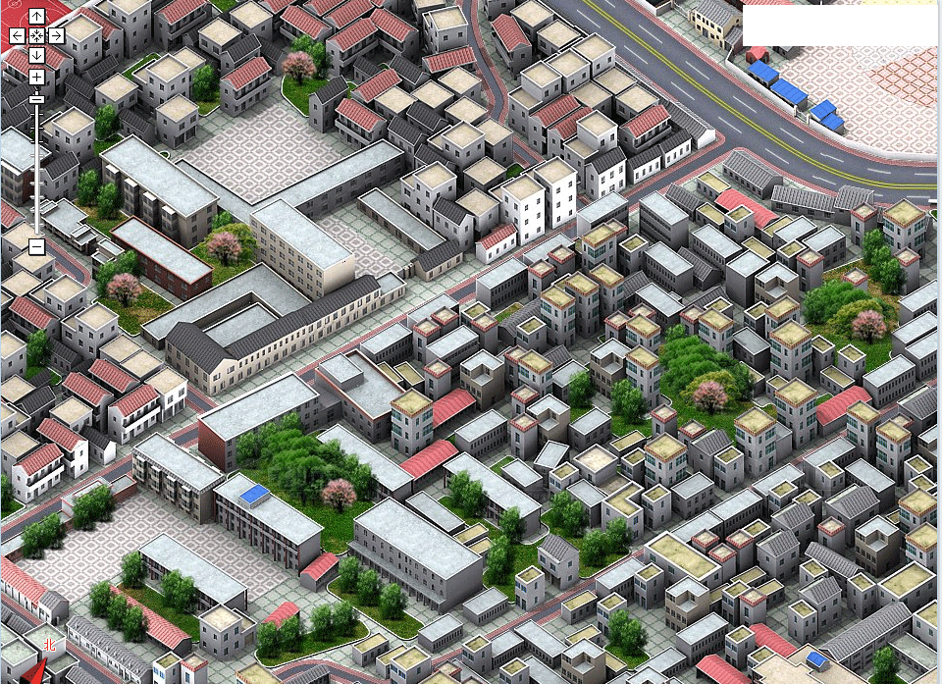
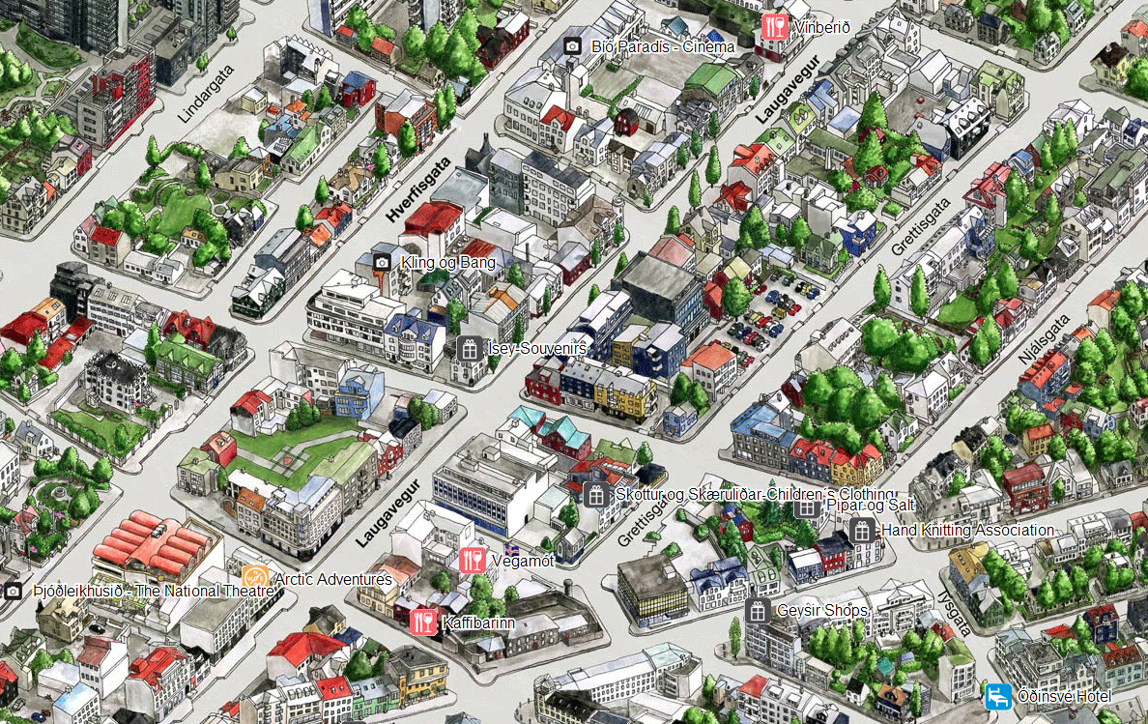
3D GIS

Slide 47
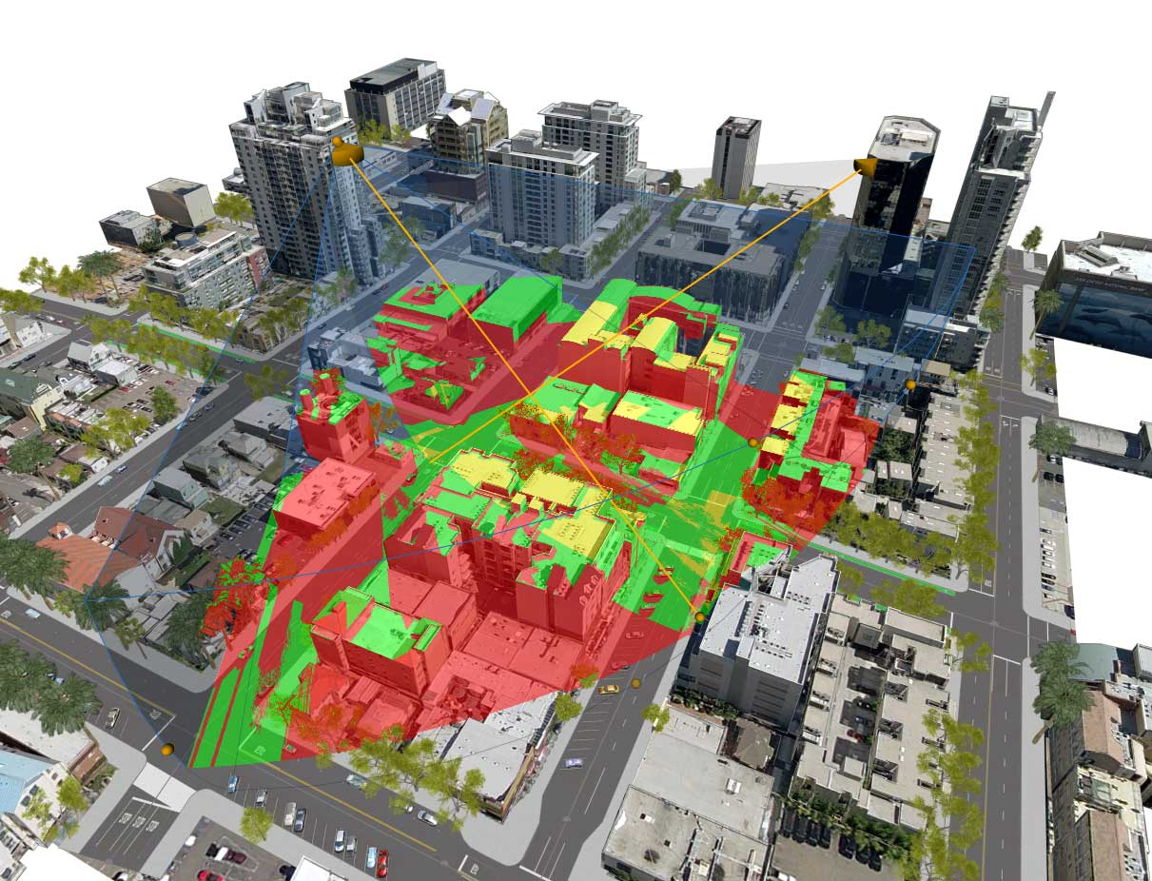
3D GIS - Visibility Analysis - CCTV Placement

Slide 48
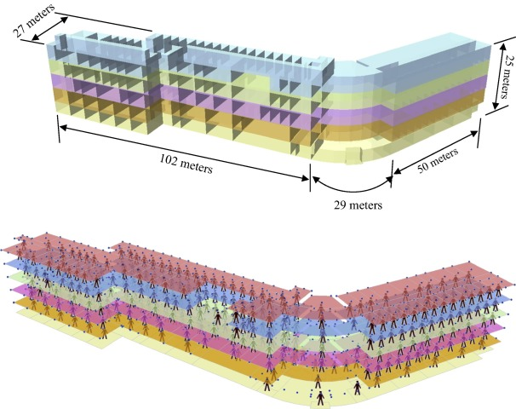
3D GIS - 3D coverage location modeling of Wi-Fi Access Point Placement

Slide 49

3D GIS - 3D coverage location modeling of Wi-Fi Access Point Placement

Slide 50

3D GIS - BIM - GIS Integration

Slide 51

3D GIS - BIM - GIS Integration

Slide 52

Mapping the IoT
OGC Standards:
SWE (Sensor Web Enablement) Common Data Model
SWE Service Model
SensorThings
Sensor Model Language
Sensor Observation Service
Sensor Planning Service

Slide 53

GeoSpatial Big Data
Point Cloud

Slide 54

GeoSpatial Big Data

Slide 55

GeoSpatial Big Data
Flow Visulization

Slide 56


GeoSpatial Big Data
Flow Visulization

Slide 57

GeoAI
Deep Learning in remote sensing image Calssification

Slide 58

GeoAI
Deep Learning in remote sensing image Calssification

Slide 59

GeoAI
AI-assisted Building Footprints

Slide 60

GeoAI
Landmark Recognition

Slide 61

Technology Fusion - Location-based Game

Slide 62

Technology Fusion - Self-driving car

Slide 63

Technology Fusion - Self-driving car

